Slide 1
Auto Populate your forms
Matt Smith – Presales Consultant (Global GBM)
Technical Enablement Webinar Series (Online)
26/3/2025 (10am Brisbane,
11am Sydney/Melbourne/Canberra)

Slide 2
About the Webinar
10 minute
Slidedeck and Live demo presentation
5 minutes Q&A
OR post Questions in webinar chat
Follow up questions can be sent to matt.smith@
globalgbm.com
OR sales@globalgbm.com
The webinar recording will be available after the session for those or your colleagues that couldn’t make the session

Slide 3
How to Auto Populate a form in Konect?
Auto Populating a form in the Konect can occur through the structuring of the form
And/Or
The import of the data into a Konect instance using the application CLI or API
This webinar will focus on the form components only

Slide 4
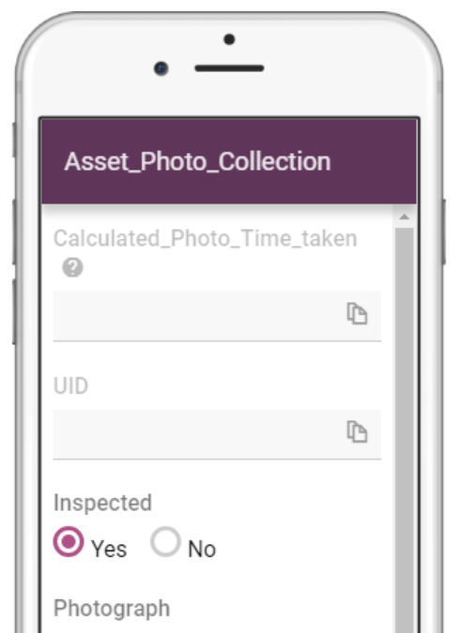
Why Auto Populate forms in Konect?
- Reduce instances of manual data entry
- Build on the level of detail within your field data collection
- Utilise Konect on – the – fly nearest point & spatial object within auto queries
- Leverage organisational GIS data within Konect
- Utilise open data available from third party organisations to add relevant attributes to forms

Slide 5
Demo Scenario: Building & Open Spaces Works Management
Fred works for an asset management company and is responsible for inspecting as well as maintaining infrastructure assets around South East Sydney.
Sydney Airport exists within his work area, alongside the freight rail line from Sydney’s inner west to Port Botany which runs around the airport.
Fred is also focussing on monitoring storm tide and flood risk in specific suburbs he undertakes his inspections within
When undertaking an inspection and collecting data in the field, it would be ideal for Fred to be able to auto populate a form with geographical attributes for the following reasons
To ensure that infrastructure details are automatically captured at the point of inspection
To ensure that cadastral (property details) are automatically captured
To capture storm tide and flood risk data at the suburb level (if a location is recorded within a 500 m radius) at the time of the inspection
Fred is an asset management and service professional, not a GIS expert.
However, Konect manager users can setup these smart forms and link to spatial data within a Konect instance

Slide 6
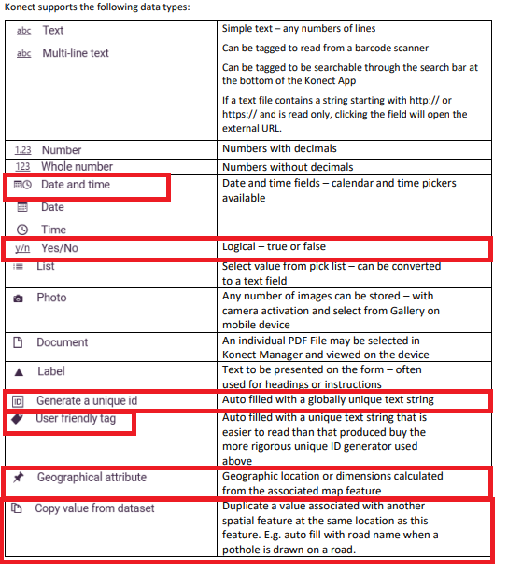
Auto Populate forms using the Konect Manager
Feature Overview/Demo

Slide 7
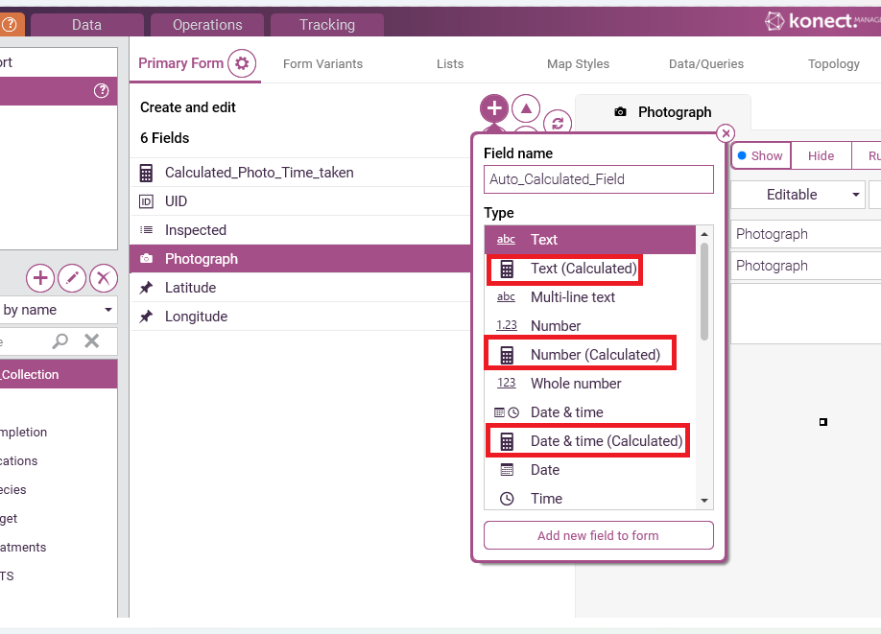
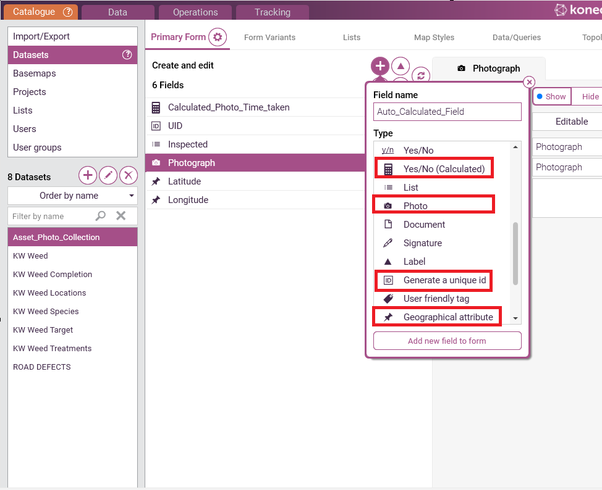
Auto Populate forms using the Konect Manager – Catalogue tab
Konect forms are built to help you auto populate data v

Slide 8
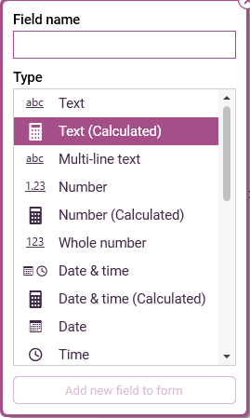
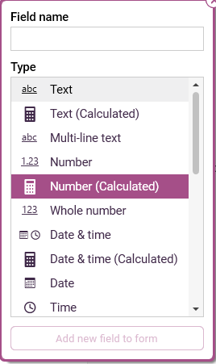
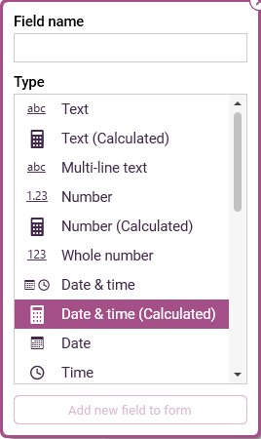
Auto Populate Function 1: Text, Number & Date/Time (Calculated)
Expression Based Rules

Slide 9
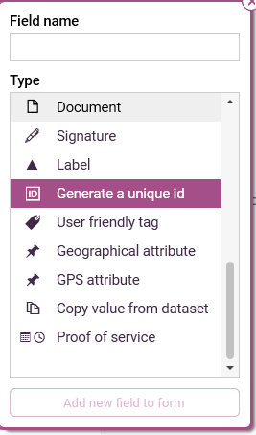
Auto Populate Function 2: Generate a Unique ID or User Friendly Tag

Slide 10
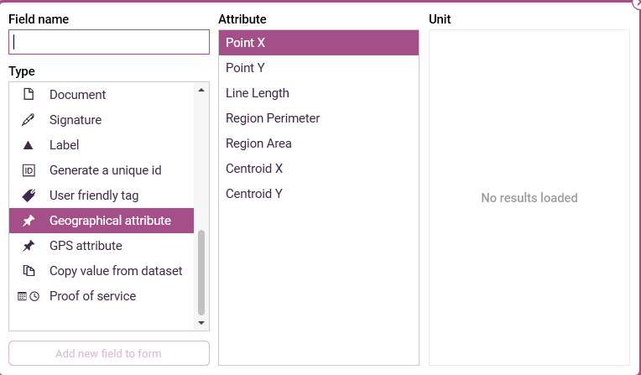
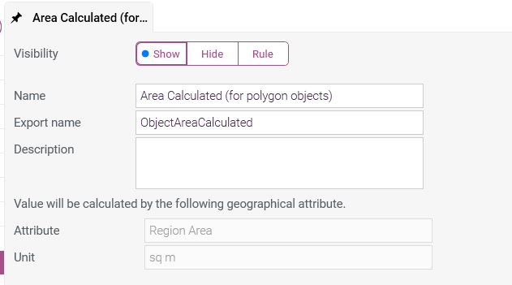
Auto Populate Function 3: Geographical Attribute

Slide 11
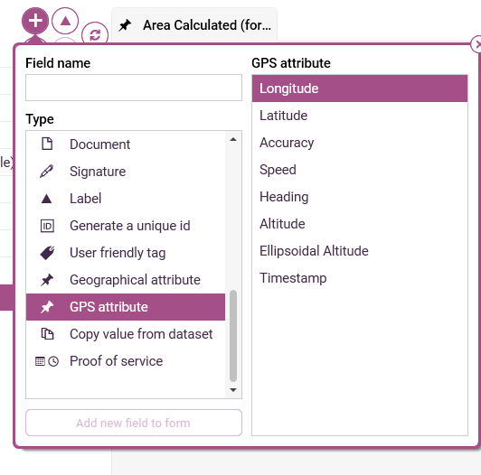
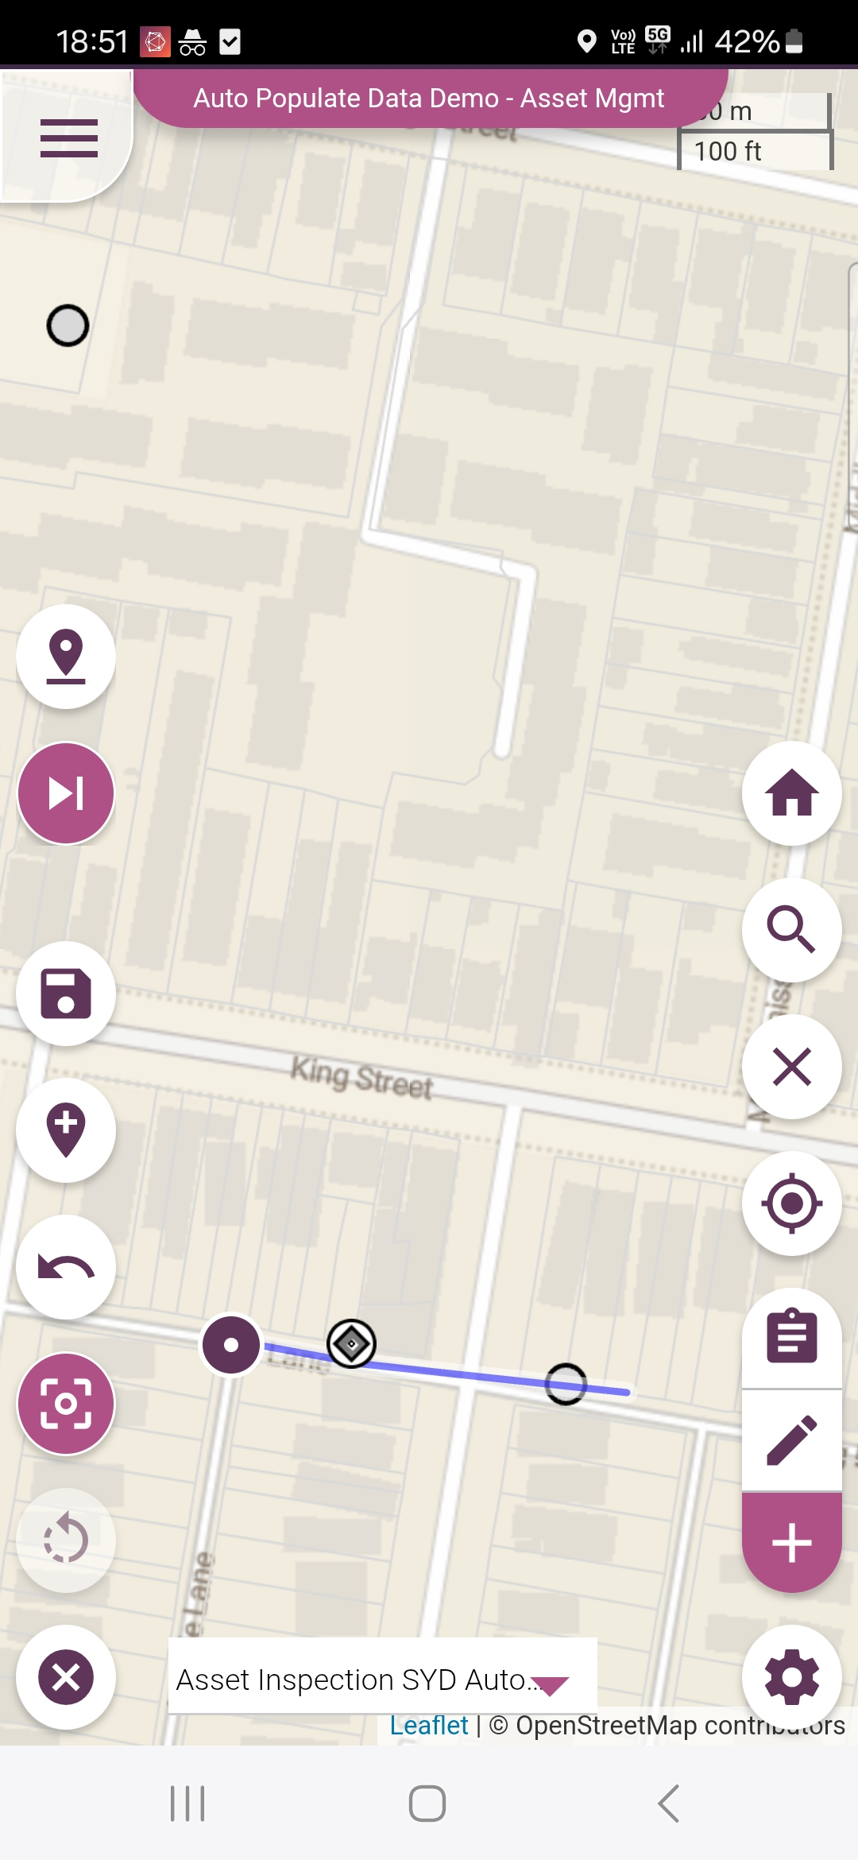
Auto Populate Function 4: GPS Attribute

Slide 12
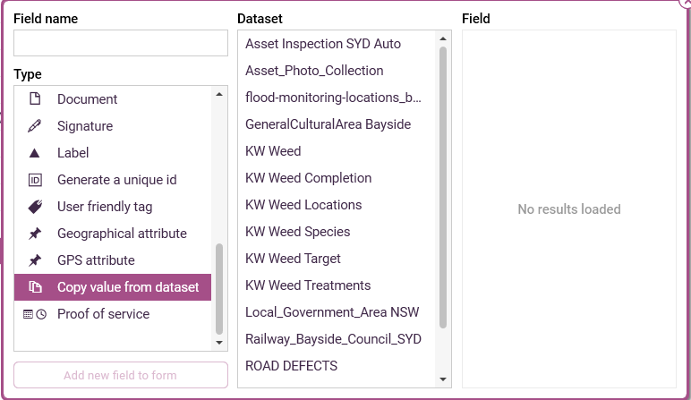
Auto Populate Function 5: Copy Value (definition: object within or nearest)

Slide 13
Note of Caution !
Test before deploying to users in the field – as always
Be mindful of the complexity of the GIS data you are importing into the system. Like any software, this may have performance implications
Data may need to be processed prior to load

Slide 14
Documentation available re form functions
Calculated fields technical documentation
https://api.konectech.com/docs/integration/calculated-fields/index.html
Konect Quickstart guide
https://s3-ap-southeast-2.amazonaws.com/konect-documentation/Konect_Quickstart_Guide.pdf
& Stayed tuned for updated resources

Slide 15
Ways to get in touch
Ask our chatbot @ gbmkonect.com
Have you joined the Konect User Forum?
forum.gbmkonect.com

Slide 16
Follow up Questions?
matt.smith@globalgbm.com
OR sales@globalgbm.com

